Slide 1
Group 3 – FCEPH
Team Project
Anis Subba - Jennifer Odongo - Benjamin Mapamboli - Nazir Mohammmad
https://github.com/AKLBeast/AKLbeast-

Slide 2

Introduction
This project requires us to develop a software as group of four.
Define our project specification and roles.
Looking at different and necessary factors required in this project.
The aim is to engage in a collaborative team.
The idea is to develop an integrated information system for a supermarket.

Slide 3
FCEPH | Review of Roles - Anis
Non-Technical Role – Project Manager
Taking minutes
Creating the project plan
Contribution to Development
Creating the page with the list of items

Slide 4
FCEPH | Review of Roles - Jennifer
Non-Technical Role – Documenter
Documenting everything
Work Breakdown Structure
Overall Project Lifecycle
Contribution to Development
Login page

Slide 5
FCEPH | Review of Roles - Benjamin
Non-Technical Role – Quality Assurance
Checking the quality of work produced by the team
Risk Register
Contribution to Development
Creating a database

Slide 6
FCEPH | Review of Roles - Nazir
Non-Technical Role – Integration
Planning how the extra components will be integrated into the core software
Contribution to Development
Creating the page with the items information

Slide 7
FCEPH | Project Plan
Our project objective is to create an application and website for the supermarket. To accomplish this we created a project plan. This helps us set guidelines and create structure to our project and team.
Our project plan contains:
A definition of everyone's roles
An outlining of what software and resources are used
A weekly work schedule
The supermarket name
The colour scheme. Green, Blue and White
The logo
Etc.

Slide 8
FCEPH | Project Plan
Core Requirements
Login/Register Page
Delivery Page
Customers should be able to log in or register.
Products Page
Checkout Page
Customers should be able to choose a delivery date for their items.
Customers should be able to view the items available.
Item Page
Basket Page
Customers should be able to checkout items in their basket.
Customers should be able to select items and view a detailed description.
Customers should be able to add items to basket.

Slide 9
FCEPH | Project Plan

Slide 10
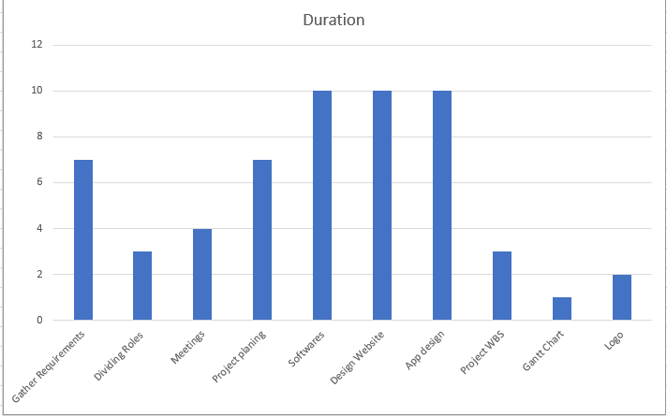
FCEPH | Project Plan | Gantt Chart

Slide 11
FCEPH | Progress - Week 1&2
In Week 1 and Week 2 all we have mostly done is sorting into team of 4.
In the following week we have been deciding what role we are going to do in this project.
We have also logged in the GitHub which will be our website where we can communicate, update, share information and work.
After that had a long chat on the possible idea for the project. From what we had discuss we will be making a rental shop which will sell groceries, cloth, pharmacy, household and electronic.
We then defined the specification like language needs and requirements need to be done to finish the project like name, slogan, colour scheme, logo , WBS , charts and as on.

Slide 12
FCEPH | Progress – Week 3&4
In this following weeks we had been ticking the specification list one by one like name FCEPH which is the first letter of the product we will be selling like Food, cloth, Pharmacy, Household. Possible slogan like low price, high quality! Bring quality to you. Colour requirement like white, green blue.
Jennifer and Benjamin has started the web designing, while me and Nazir will be doing the mobile app development.
We also made the WBS which the lecture was based on. Were we jog done all the activities and task which need to be done at certain area of time to finish the project.

Slide 13
FCEPH | Progress – Week 5
We used Gantt chart to give us a graphical representation of a project schedule .
Gantt chart allows us to plan , coordinate and track specific tasks in the project
It shows the duration of each task took.

Slide 14
Ideas accessed from other supermarket apps!
(2)
This is the Aldi, some of the features that I have noticed are :
Instruction on how to function the app.
Sliding Menu bar.
Basket action bar
(3)
This is ASDA Mobile App. Some of the Mobile app features noticed :
Big Image with a slogan.
Sign In and Create Account button.
Item box (Home, Shop, Favorites, Orders, Account) .
Search Bar, micro speaker bar and basket bar.
Frequent Searches database.
Image buttons.
(7)
After looking at different supermarket mobile app I have found some similarity which I have thought of adding in our mobile app:
Sliding menu bar
Search bar
Sign in and register button
Image button which will link to different layout
Image related to the core
logo
(1) This is were we got all the ideas about the mobile app. After analyzing all the other supermarket mobile app and bulleting pointing the requirement and similar features.
(6)
This is Tesco Mobile App which has lot of features :
Logo
Sliding Menu Bar( groceries, favorites, seasonal buy list, book a slot, order, special offers, club card)
Welcome image with Sign in and Register Button
Groceries view all button and Special Offer view all button
Barcode reader, search action bar, basket counter as well basket action bar
(4)
This is Sainsbury’s Mobile App and some of the features that I have notices are:
Sliding menu bar (home , browse, great prices, favorites , log in and more..)
Image on sliding menu bar
Image button
Log in and register button
Search action bar and basket action bar

Slide 15
App Breakdown!!
Display with start screen with image button and sign in and register and menu bar to link to different layout.
Show list of all the stores.
Show sign in and register button and search / basket action bar.
Display list of groceries, pharmacy, electronic and the price and details in different layout.
Display a menu list, favorite, order list and club card option.
Get contact info and location on the store or write comments.
Show each detail of all groceries, pharmacy, electronic in the layout.
Show the menu list which will have the deals from different area.
Show all the favorite items in the list with it info.
Open a page with requirement to sign up or log in.
Press and search for the item required as well see how many you are buying.
Show loyalty card point and deals
Show all the recent order list and how much it cost.

Slide 16
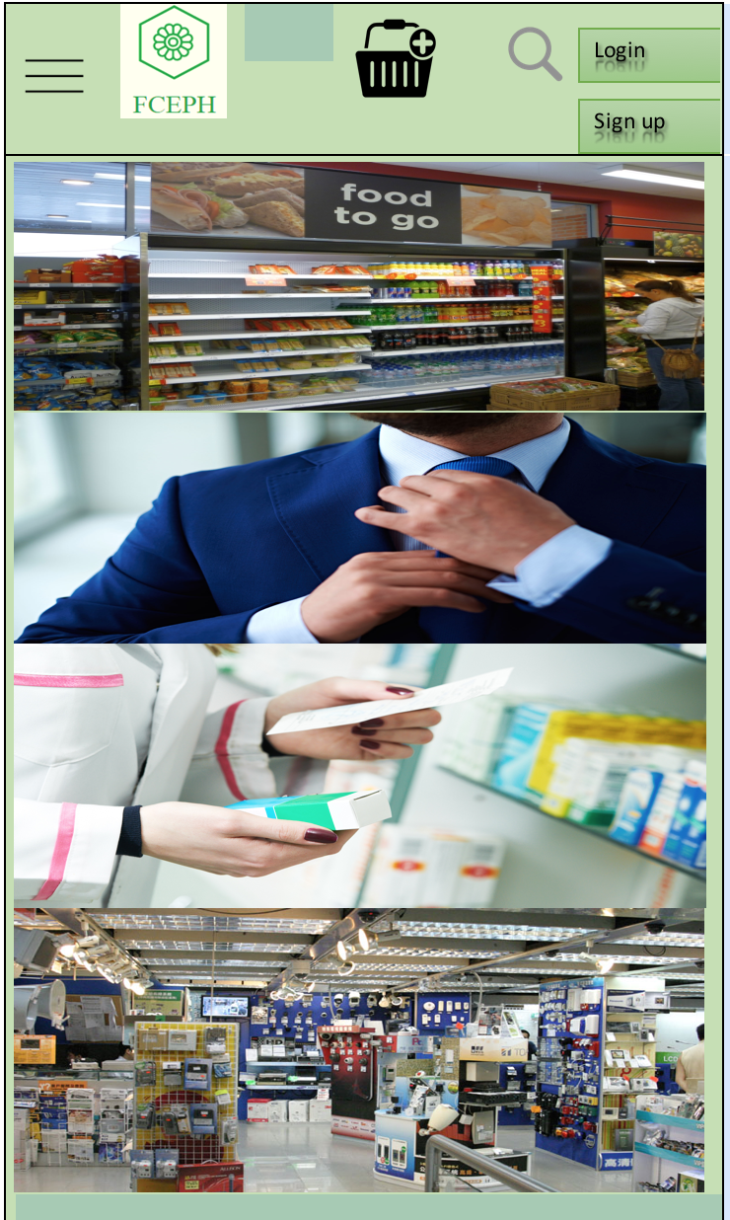
Mobile App design
Home Page
Core Requirement - Customer should be able to view items.
Core Requirement - Customer should be able to filter items on view.
Core Requirement - Customer should be able to select items.
Core Requirement - Customer should be able to add items to a basket.

Slide 17
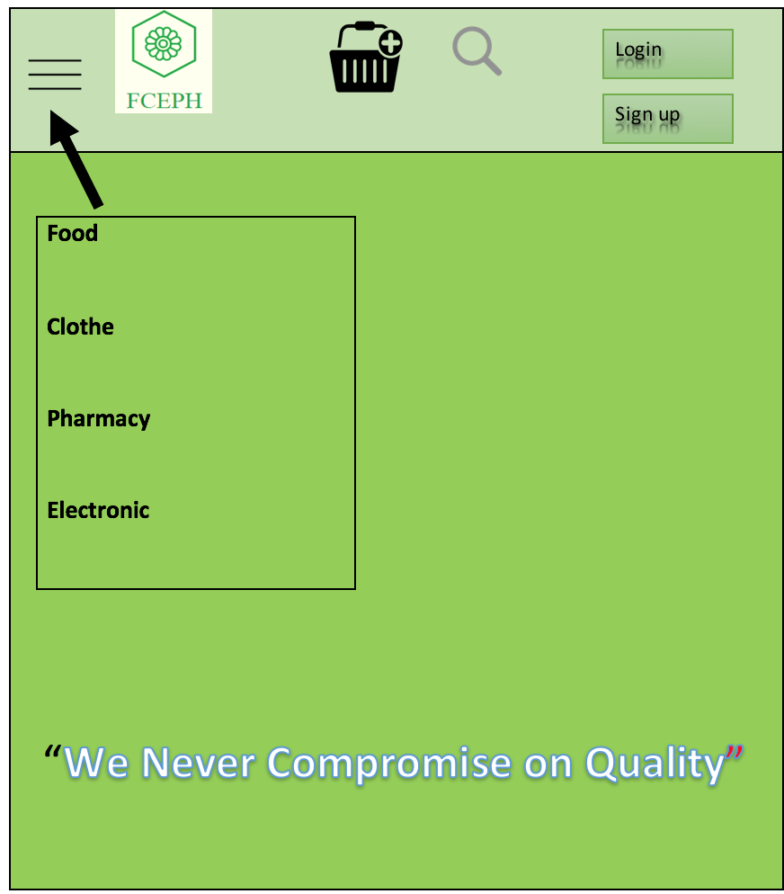
Home Page Categories
Utility at the top (With search, login, Sign up and basket.
Menu bar (Food, Clothing, Electronics, Pharmacy

Slide 18
FCEPH | Conclusion - Future Progress
This module give us the experience of team work.
Perform individual work and participate in collective tasks.
To finish the app and website in time to get each other feedback and give it out with no worries.
Finish the logbook and documentation on the whole project which is suitable to hand out.

Slide 19
Any Questions?

